Slide 1
Making Database Server Healthy and Faster
WWW.MSSQLPLANNER.COM

Slide 2
01
We help making Information Technology Infrastructure Database server healthy, faster & Error free. We feel excited everyday to build happy Admin, developer and end users experiences.
WWW.MSSQLPLANNER.COM

Slide 3
02
AN OVERVIEW OF THE PROBLEM
Servers slowness, Issues
02. Expensive
03. Many Tools & Complexity
Request may be taking high resources which without proper / advance monitoring technique – cant be detected
Complete Solution from other competitor Starts with 4000$ Per Server minimum
To Do multiple Database related task , folks need to have multiple tool
04. Missing Capability to investigate Root-cause of Problems
05. No Remediation and Auto Apply solution to Problems
WWW.MSSQLPLANNER.COM

Slide 4
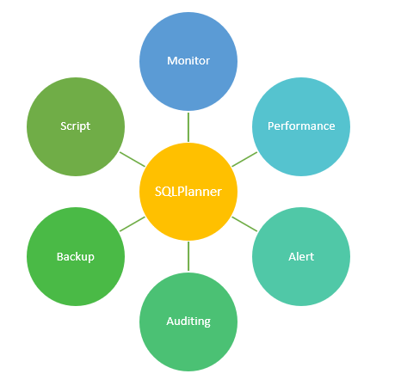
03
SOLUTION / COMPETITIVE ADVANTAGE
Centralized Platform
AI based Automation
Reduce Org. TAT by 90%
1 tool for all solution to the technology in this segment from anywhere and anytime.
Many Custom Manual Activities are Automated
Allows Team to respond 90% faster than traditional way
1 tool : Many-Action
Ease Of Use / Cross Platform
Cut Expense by Million $
SQL Planner has package in just one software to perform several Task – Monitoring, Alerting, Health Analysis, Backup , Auto Restore, Index defragmentation ,Scripting, Automation
SQL Planner being browser base software supports user to work from any device and any location and let them do critical job – professional look easy to navigate.
Helps your Org to reduce your Database related Resource cost by minimum of 70% (Millions of $) with its Automation.
WWW.MSSQLPLANNER.COM

Slide 5
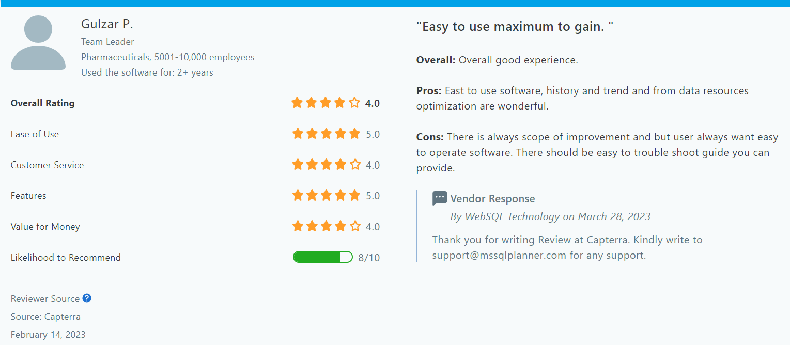
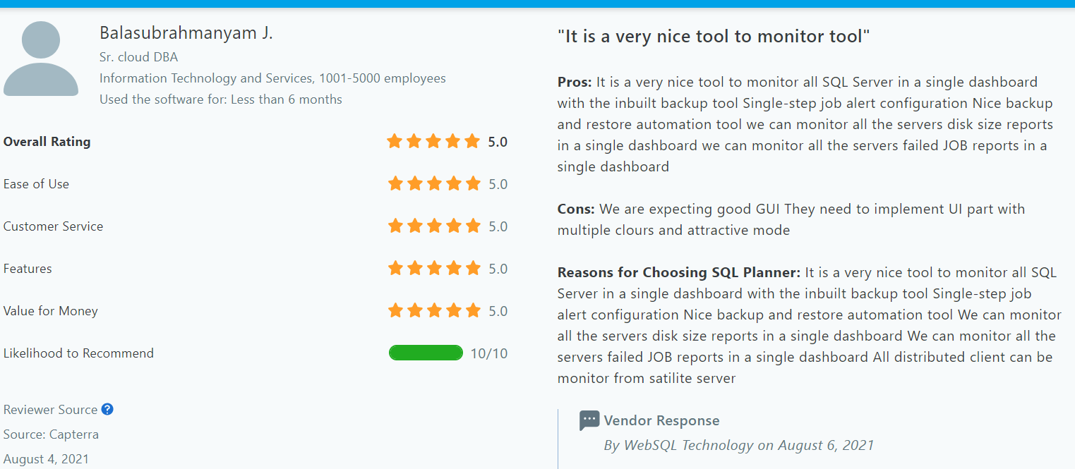
SQL Planner Reviews – More review at Capterra Website here
04
What Clients says about SQL Planner

Slide 6
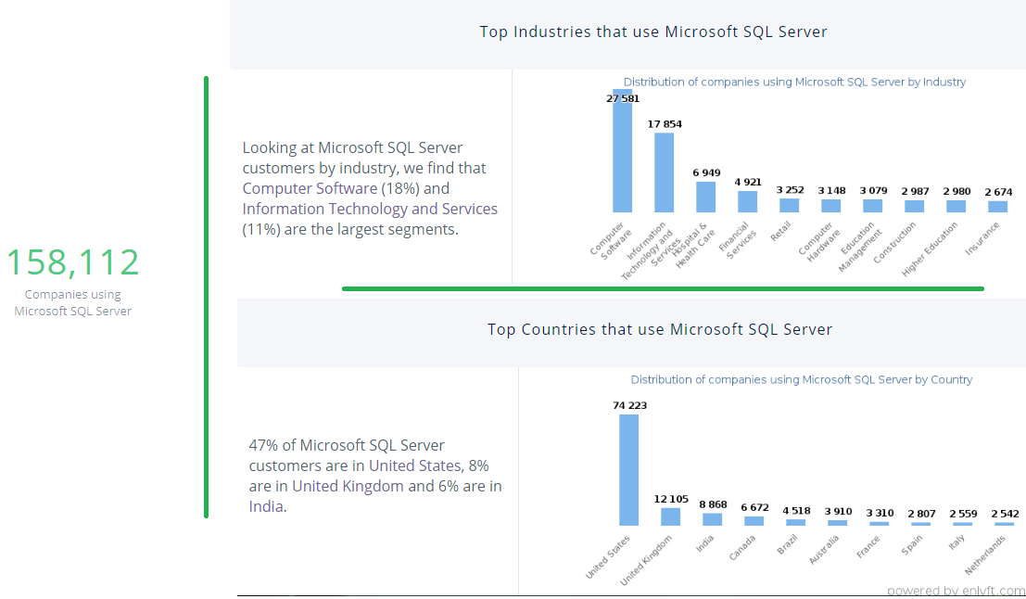
05
THE SIZE OF THE MARKET
MARKET SIZE
Any Organization that uses Microsoft SQL Server as the database technology and it has been always in Top 3 since last 15 years, compare to other DB.
Notes:
https://enlyft.com/tech/products/microsoft-sql-server

Slide 7
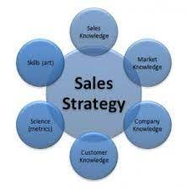
06
Market & Sales Strategy
We need to build sales team from start to
01. Sales team to sales activities
02. Affiliate Program
03. Paid Per Click, Online Campaign
04. Social Media presence, Google , Microsoft search engine, SEO
05. Occasionally Offering 1 months of Licensed software for free
05. Collaborate with Corporates and Enterprises

Slide 8
07
PRODUCT DEVELOPMENT ROADMAP
We have plans to upgrade the product with following features, in 1 central tool as a solution :
01. Supporting Multiple technology like Oracle, MySQL, Postgres, Azure, AWS, GCP
02. Visual Appearance as per latest trend
03. Mobile App – an awesome feature which will make us unique in world.
04. Multiple features like Backup , Indexing, statistics tool enhancement
05. Application and Network Monitoring too in single tool
06. AI based solution to common problems

Slide 9
08
CURRENT PROBLEM and FUND
Current Problem
- Sales Strategy – To boost sales, we need sales team and strategy to collaborate with Enterprise
- Become Enterprise
Fund Problem
3 - 4 Cr INR Per year investment towards :
- Human resource for Product enhancement and roadmap
- Office Infra and Setup
- Human Sales Team and Online Sale Platform Cost

Slide 10
09
DILUTION
Partnership at 25%
ROI
First Year – we can try best to achieve at No Profit No Loss – however if could get medium or large organization, ROI can be 50% expected –though being startup its hard to predict.

Slide 11
10
COMPETITION
Big Competitors who are making Trillions with similar software product

Slide 12
11
PRODUCT STRENGTH
AND OPPORTUNITIES
STRENGTH
OPPORTUNITIES
Centralized Multiple capabilities
AI Based Solution
Bundles of feature in 1 package
Massive Demand to move on to cloud & work from anywhere & any device
Affordable
Automation
WEAKNESS
THREATS
Competitors –
Brand popularity
Few Giant Branded Competitors

Slide 13
12
MEET TEAM
Chandan Sahu
Sonali Sahu
Manish Kumar
On Demand Freelancers
MCA , MCP
15 Years of exp. in IT
SQL Planner Founder , Owner
Business Director
Account Management
Development activity

Slide 14
THANKS FOR WATCHING
WWW.MSSQLPLANNER.COM
Write to: chandansahu@mssqlplanner.com
Or : chandansqlexpert@gmail.com

