Slide 1
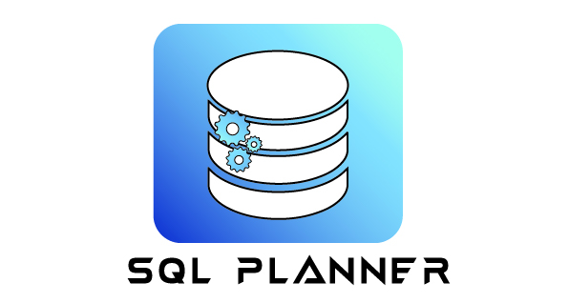
WINGS TO DBA
SUPPORT FROM ANY DEVICE, ANYWHERE
WWW.MSSQLPLANNER.COM

Slide 2










Why SQL Planner - Centralized Tool for
In-Depth Monitor & 100+ Alerts (Customized)
Special Dashboard For SQL Always On (HA)
Slowness Root-Cause Finding in A minute !
SQL Auditing – Compliance, Security, Troubleshooting, Risk management
DBA Task Automation – Saves Resource manual work & time
Database Backup and Alerts
Multiple SQL Server Tools, Centrally Operated – Scripting, Backup, Handover Notes, Index Frag. Dashboard Etc..
70% Low Cost

Slide 3
Customization ? Ask us to automate your manual task @0 fees.
Backup in Script format
Why SQL Planner

Slide 4





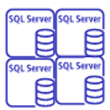

SQL Planner Architecture | Components
Org Network
Manage | Analytics
Users
Local SQL Planner
Alert User for Issues
SQL Servers To be monitored
SQL Planner Repository
Cont. Monitoring
Background app

Slide 5



PRODUCT Demo & Whitepapers
Having thousand of server and not sure where to start ? SQL Planner helps org to focus on server having issues, alerts you, helps in finding RCA quickly
with Remediation.
Finding Root cause in a minute !
Report with CPU, Memory Usage, Expensive Queries, Deadlock , Blockers etc
From Where To begin for the Day – Read Alerts
Shows all Servers running with issues and Remediation to users
Server Audit – Track Who, What & When Modified
Know when someone changed Server settings or modified eg. Login created, password modified, Invalid login etc
Analysing SQL Server Health, Storage, Index Fragmentation, Waits, Backups, Task Management
When you want to analyse server performance, analyse storage growth , why server is running slow, Which database is missing backup etc
SQL Planner has all reports that pin points to root-cause area with Remediation. Task Management is a free utility helps team to manage
all activity and communication from SQL Planner itself.

Slide 6
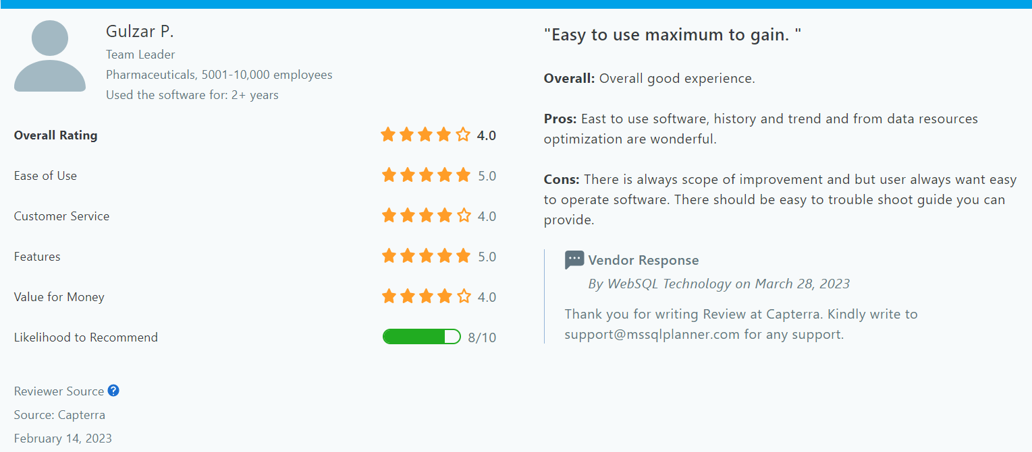
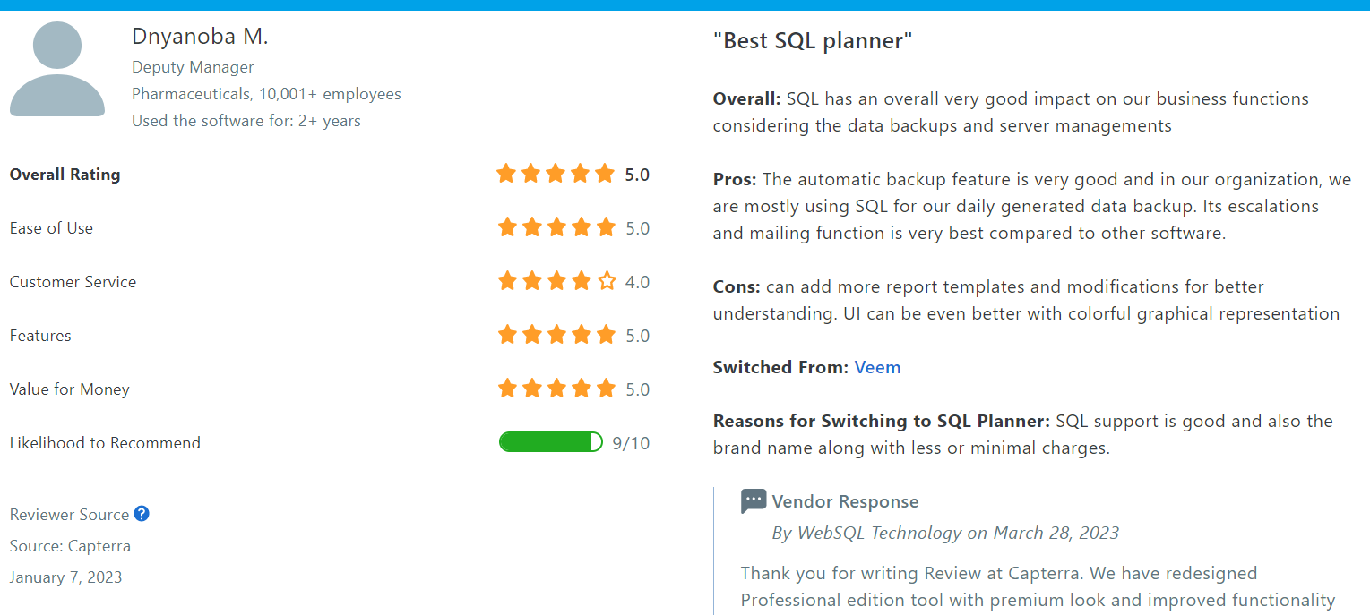
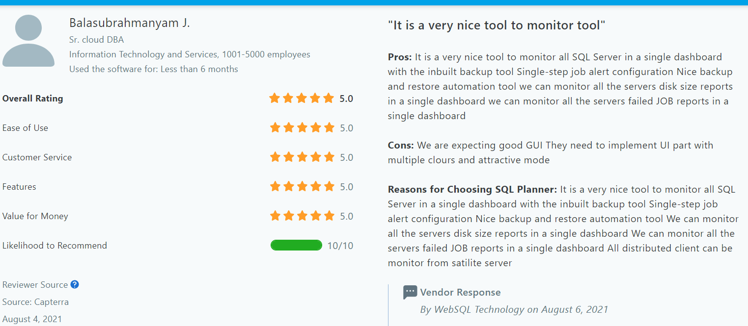
SQL Planner Reviews – More review at Capterra Website here
What Clients says about SQL Planner

Slide 7



PRODUCT FEATURES
Clients
One SQL Planner and Several Automation :
01. SQL Server Total Monitoring, Alerts ,Health Analyze – Historical + Live
02. SQL Server Backup , Restore
03. SQL Server Index defragmentation, Statistics Update
04. SQL Server Scripting and Automation
05. SQL Server Auditing
06. Task Management or Handover Notes Management
Security
01. Encryption : Sensitive Information stored in encrypted format in SQL Planner Database
02. Certified by Softpedia Lab : Safe from backdoor, Malware, Virus, Trogen Etc..
03. Advised to Modify SQL Planner default password after install
04. Use your own Mailing provider or DB Mail to send alerts

Slide 8
02
SQL Planner Features in a nutshell
1. Get all Top Servers with high resource consumption, Issues (Helps to realize issues within a second)
2. CPU , Memory usage - for SQL , Non SQL and Total Usage
3. Performance Counters
4. IO (Read Write) Database and File wise
5. Deadlock - Hourly count, Detailed report
6. Blocked - Hourly count, Detailed report
7. Storage Analysis - By Database, Table and Drive
8. Server Heartbeat and filtered SQL Server Log Errors
9. Missing Index
10. Top Expensive Procedure
11. Expensive Top Queries by CPU and IO
12. Server Configuration
13. Server Waits
14. SQL Server Agent Job Monitoring
15. Index Fragmentation Reports and Defragment
16. SQL Server Database backup, validation, auto-restore automation
17. Scripting Automations
18. Supported to work from Mobile , Tablet , Laptops , Desktop , any OS

Slide 9
03
SQL Planner Features in a nutshell
18. Alerts are sent via Email Text format and is visible from SQL Planner Menu anytime.
19. Monitor Centrally from one location to all of your Clients (SQL Planner Server – Client Architecture)
20. Supported Platform : On Prem, Linux, VM in Cloud, Managed Databases (Azure , RDS etc).
21. Audit Feature : Coming Soon in next release
22. DBA Handover Notes Management
23. We can customize SQL Planner and add reports, Alerts as per your need too.
Important Website Link to refer in detail :
Monitoring Features here
Pricing here
Download here : Choose Professional Edition

Slide 10
04
SQL Planner Load on Prod Server
Q : If I monitor my prod server how much load it will generate on SQL Server ?
A: Overall it is always 0.2 % or lesser CPU consumption when SQL Planner will pull resource usage data, our tool is designed to pull only necessary data on specific frequency , for ex Heartbeat and CPU Usage will be pulled at 1 minute frequency , Block and deadlock are pulled at 10 minute of frequency , Storage usage are pulled at 6 hour of frequency etc to ensure there is least load while monitoring.
Q : If I monitor my prod server how much IO pressure will be generated?
A: it pulls only 100 rows per minute which will be 100 KB at maximum. Where as waits related data will be pulled every 4 hour frequency, the amount of data will be that extended event would capture , is generally approx. 10 MB.
Q : Will the production server impacted when analysing report in SQL Planner ?
A: No , SQL Planner is generally installed in non production machine , it keeps pulling SQL server production server usage in SQL Planner database, and it generates load on SQL Planner machine.
More FAQ here : https://www.mssqlplanner.com/faq/
Demo: https://www.youtube.com/playlist?list=PLhQL4QBn_4IziPwz5y05SS9YXpHsDA7cm

Slide 11
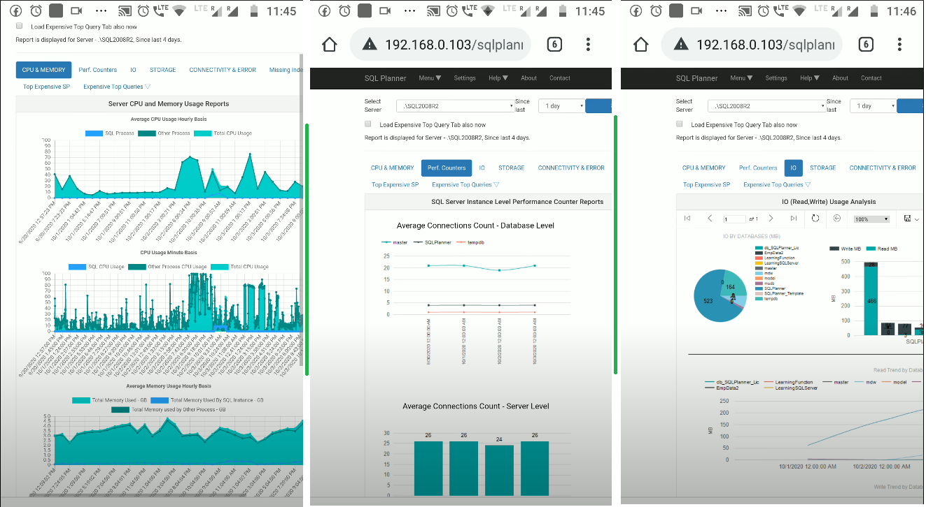
05
MOBILE VIEW
Server Health Analysis (Mobile view)

Slide 12
06
PRICE(Annual) & FEATURE COMPARISON
SQL Planner
Red-Gate
Solar Wind
COMPLETE PACK
$65 per Month
COMPLETE PACK
$4000+
COMPLETE PACK
$5000+
Backup & Automation
Backup & Automation
Backup & Automation
Monitoring ,Health Analysis, Alerts, Agent Job Monitor
Monitoring ,Health Analysis, Alerts
Monitoring ,Health Analysis, Alerts
Index De-fragment, Scripting
-
Index De-fragment
Auditing, Task Management
-
-
PC, Mobile , Tablet view
PC view – windows
PC view – windows
Other Company tool does not has Storage, Agent Job Monitoring, Index defragmentation, Scripting, Backup, Auditing features etc. in Monitoring Tool and company insist to buy separate Tools.
Major Difference is Solar Wind Supports Multiple Database technology where as Red-Gate and SQL Planner is mainly focused on MS SQL Server.

Slide 13
THANK YOU
Any Questions ?
WWW.MSSQLPLANNER.COM

